Slide 1
By Sreehari Ram Mohan
Introduction: Heart Arrhythmias occur when the electrical impulses that coordinate your heartbeats don’t work properly causing your heart to beat too fast, too slow or irregularly. Heart Arrhythmias may not cause any signs or symptoms at all, and medical examinations by a doctor have been the typical way this disease has been diagnosed.
Arrhythmia Classification:
Tachycardia - A fast heartbeat with a resting rate of over 100 beats/min
Bradycardia - A slow heartbeat with a resting rate of under 60 beats/min
Specific Arrhythmias
Ventricular Fibrillation - A deadly arrhythmia which occurs when the heart beats with rapid, erratic electrical impulses. Causes ventricles to quiver uselessly instead of pumping blood. A person with Ventricular Fibrillation will collapse within seconds.
Atrial Fibrillation – Rapid heart rate caused by chaotic electrical impulse in the atria. Results in rapid, uncoordinated, weak contractions of the atria.
Conduction Block – A block of your heart’s electrical pathways can cause the impulses between the upper and lower halves of your heart to be slowed or blocked causing slow heartbeat.
Notes:
Left 1

Slide 2
Electrocardiograph (EKG)of Normal and Abnormal Heartbeat.
In the irregular heartbeat shown on the bottom left, a beat has been skipped (Known as Tachycardia). This can be caused from faulty electrical connections to the heart.
Notes:
Left 2

Slide 3
The Problem
17.1 Million Deaths
from cardiovascular diseases in 2004
Less than 40%
of heart sounds heard through cardiac auscultation are recognized by medical professionals.
400 Million
People do not have access to essential health services such as the medical examinations performed by doctors to detect heart arrhythmias.
1 in 4
global deaths are due to cardiac conditions.
Notes:
Left 3

Slide 4
Purpose
Create a low-cost, effective early-warning system for patients to use to preempt onset of fatal heart conditions.
To use Deep Learning to accurately diagnose life threatening heart abnormalities. This involves designing a machine learning model which can determine whether a patient has life-threatening abnormalities at cardiologist level accuracy.
The hardware goal is to create a device which can take accurate heart recordings at an affordable price, and then diagnose whether the patient has a heart condition on the spot (within 1 minute)
Notes:
Left 4

Slide 5
Background/Literature Search
So far, the main way cardiac diseases are diagnosed is through a medical exam when you visits a doctor’s office. A doctor will use a stethoscope to hear your heartbeat; the sounds the doctor hears can allow him/her to assess the health of your heart and its valves. Additionally, an Aneroid Monitor is used by a nurse to figure out your systolic, and diastolic blood pressure. This information is then used by a doctor to give a diagnosis.
The crux of solving this problem lies with translating the heartbeat sound into a form that a computer can easily interpret. After reading about how Daniel Nouri, turned a whale-sound detection problem into image recognition problem by converting the sound clips to spectrograms I was inspired to do something similar.
In the past, researchers have tried to segment a heartbeat clip into the S1 (lub) and S2 (dub) sounds to get the exact location from the audio files. However the differences between these two sounds is non-trivial and the different heart sounds can be very subtle and requires extremely robust classifiers. Despite the medical significance that a breakthrough in this field could have, it has been relatively unexplored by machine learning researchers.
Notes:
Left 5

Slide 6
Software / Engineering Goals
Durable; should withstand drops from waist height.
Have the ability to record audio to send to medical professionals for further analysis.
Operate on low power; with a battery installed, the device should be able to last for at least 4-6 hours giving diagnoses every 1-3 minutes.
Patient data should be safely stored, and can be sent to medical professional for further analysis.
Low cost; less than $100 for the hardware
Small form factor; fits in the hand of a healthcare worker
Lightweight; weighs less than 1 kilogram, easy to carry and transport.
The CPU intensive software must be able to run on a Rasberry Pi 3 ARM processor using the Raspbian Operating System Environment.
Notes:
Left 6

Slide 7
Title (on Separate Power-Point) Make sure to print this!
Notes:
Center 0
Top

Slide 8
Project Stages
Gather Data
Data Preparation & Visualization
Training
Choosing A Model
Parameter Tuning
Benchmark & Evaluate
Prediction
Notes:
Middle (1, 0)

Slide 9
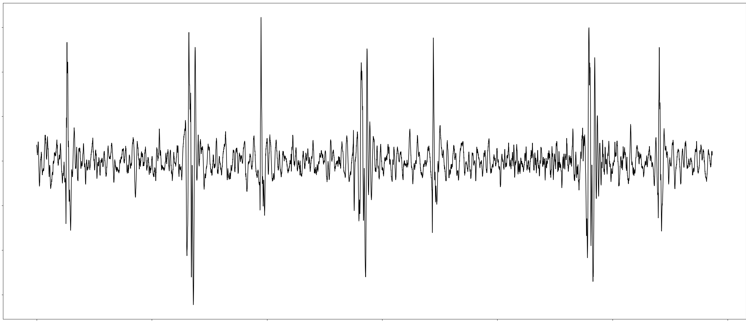
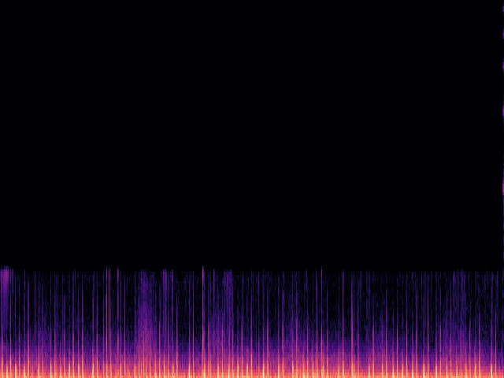
Feature Extraction
Data is recorded in waveform as a spectrogram
Mel Frequency Spectrogram Computed
Fourier Transform
Notes:
Middle (1, 1)

Slide 10
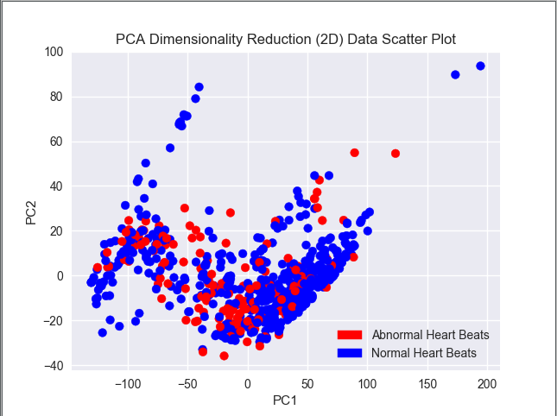
2D Data Visualization After PCA
Dimensionality Reduction Techniques (Mainly PCA) were used to visualize the dataset and ensure that their truly was a relationship between the MFCC data and the heartbeat diagnosis.
The newly augmented dataset had an explained variance ratio of 59.417258% which means that the 2D data accounted for approximately 60% of the variance. While a relationship is forming between the MFCC and the diagnosis, the data should be reduced to 3 dimensions ( + 1 Dimension) to increase the variance ratio and make the relationship more evident.
Notes:
Middle (2, 0)

Slide 11
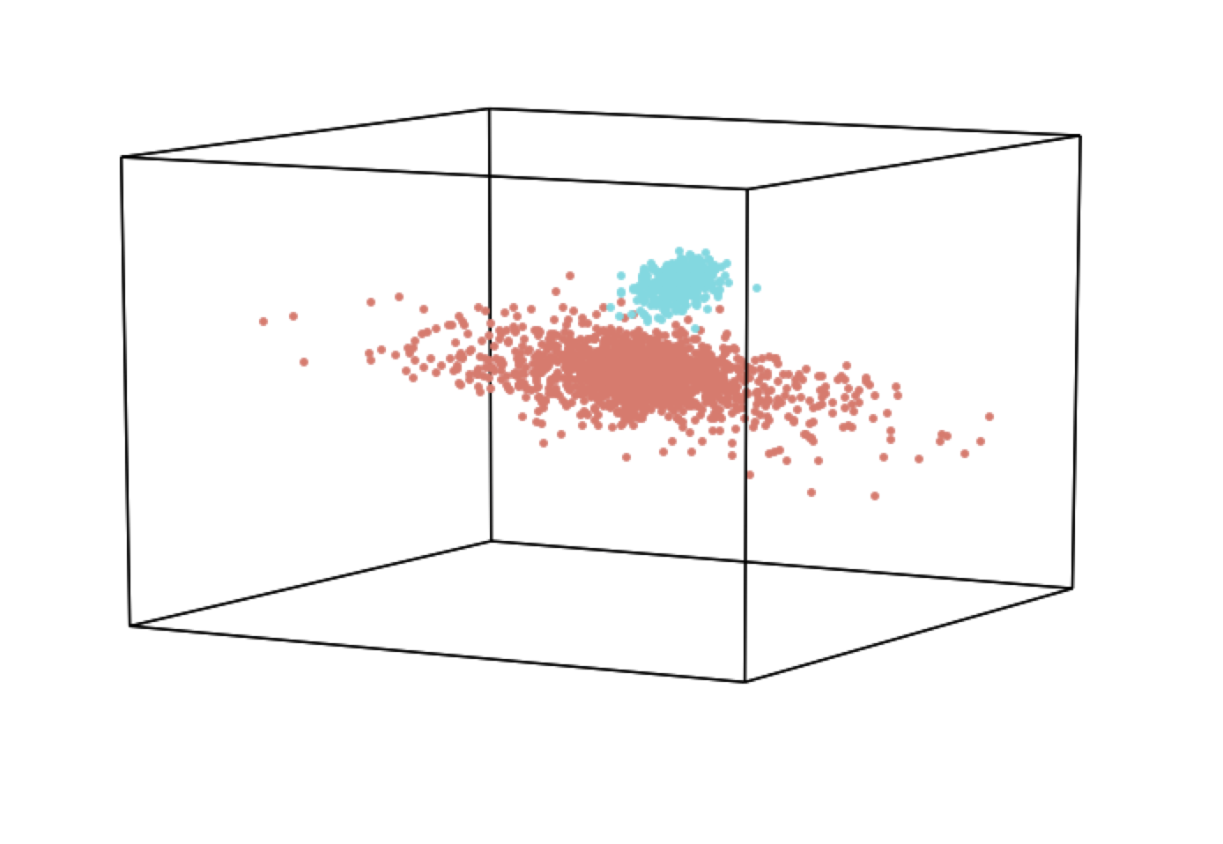
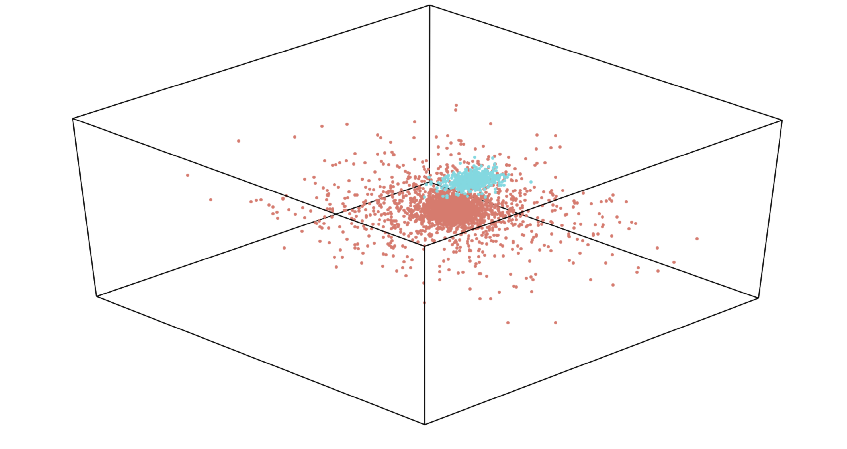
3 Dimensional PCA Visualization
Notes:
Middle (2, 1)

Slide 12
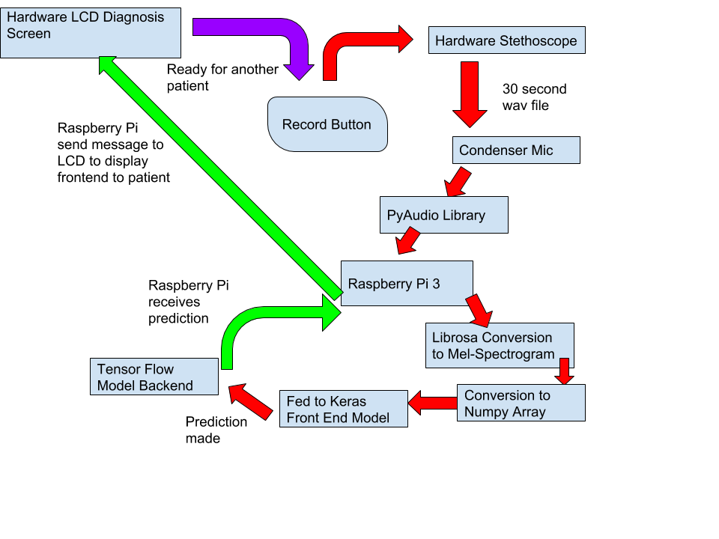
Layers
of
Abstraction
Displays the overall series of calls which occur when the device gives a diagnosis
Notes:
Middle (3, 0)

Slide 13
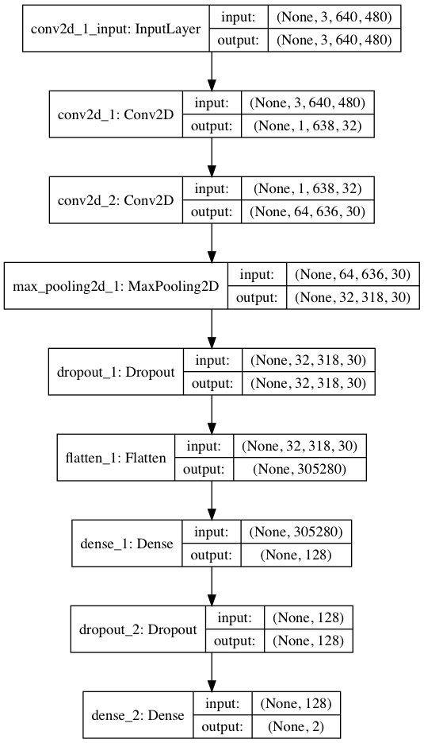
Model Architecture
Neural Networks receive an input (an image matrix), and transform it through a series of hidden layers to get an output value.
A Convolutional Neural Network was chosen because unlike a regular neural network it scales up well with images due to the fact that the neurons in a layer are only connected to a small region of the layer before it.
Basic Layers of a CNN and what they do
Convolution Layer – Extracts features from the image passed in. A filter slides over the input image (convolution operation) to produce a feature map, the CNN learns the values of these filters on its own during the training process.
Pooling Layer – Reduces the dimensionality of each feature map but retains the most important information. In MAX_POOLING we define a spatial neighborhood (2 * 2 window ) and take the largest element from the feature map. We then slide over the 2 * 2 window over by 1 stride.
Fully Connected Layer – Every neuron in the previous layer is connected to every neuron on the next layer.
Notes:
Middle (3, 1)

Slide 14
Model Performance Comparison
Notes:
Middle (4,0)

Slide 15
Model Prediction Time Comparison
Notes:
Middle (4, 1)

Slide 16
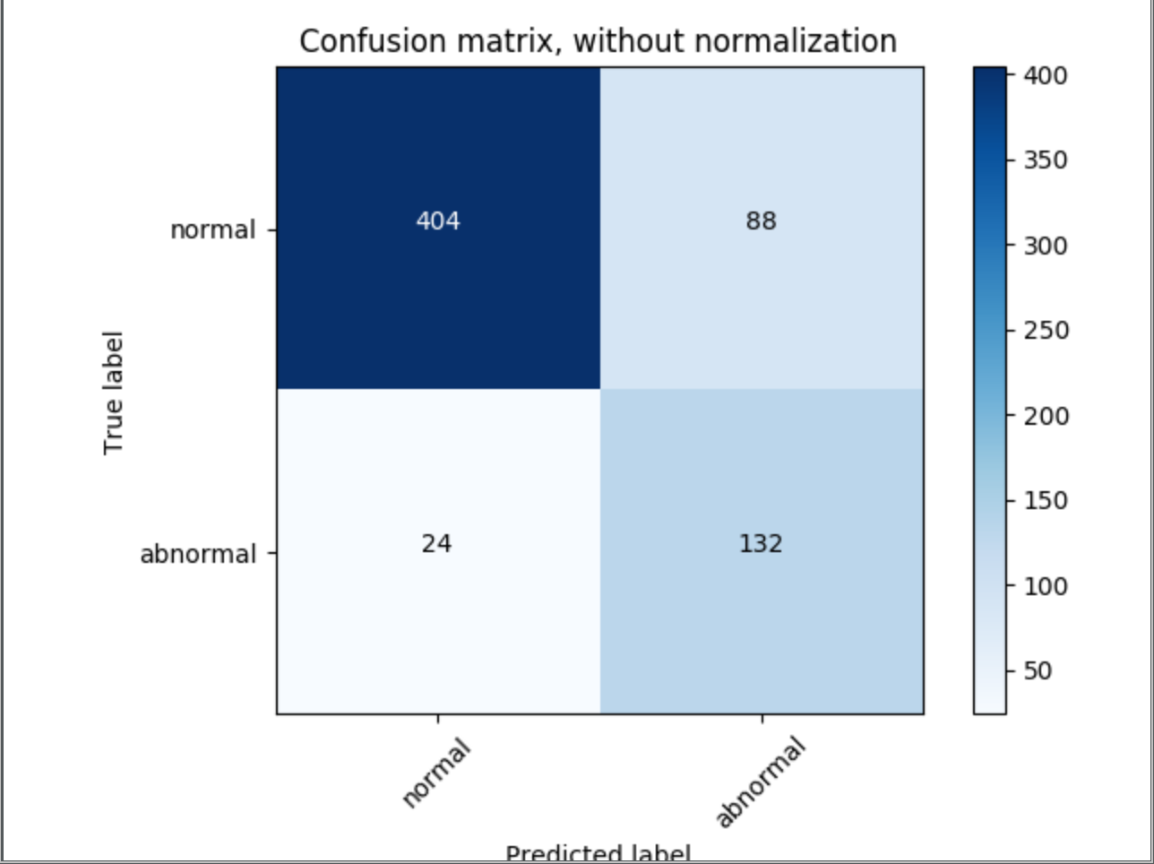
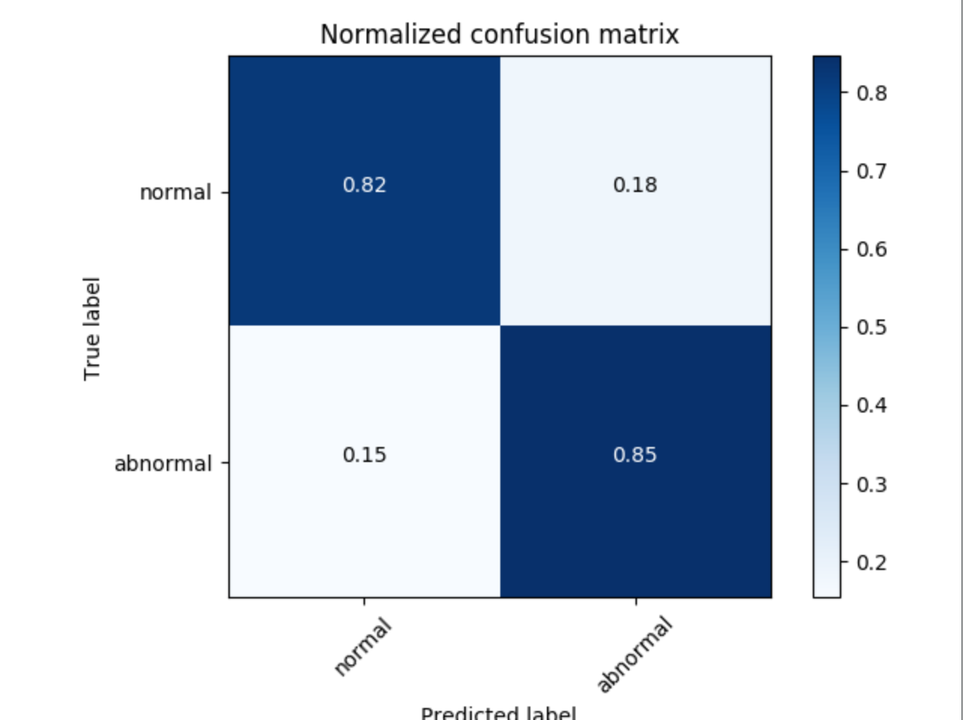
Confusion Matrix for the Convolutional Neural Net
Notes:
Middle (5, 0)

Slide 17
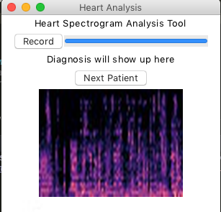
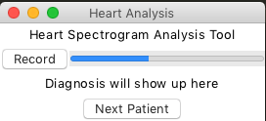

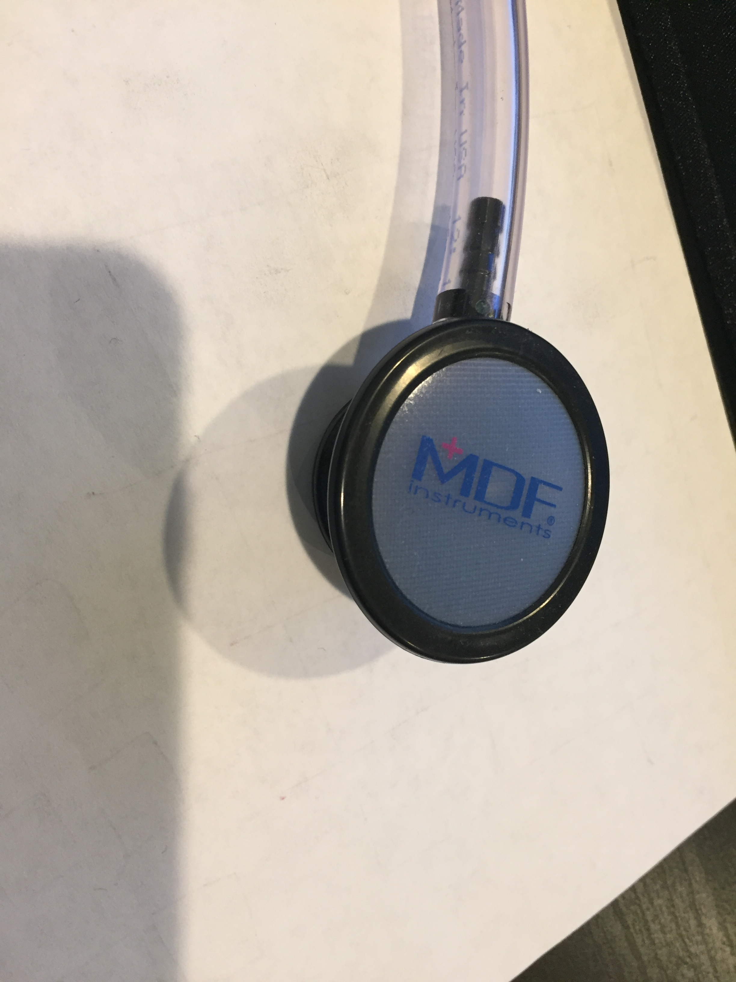
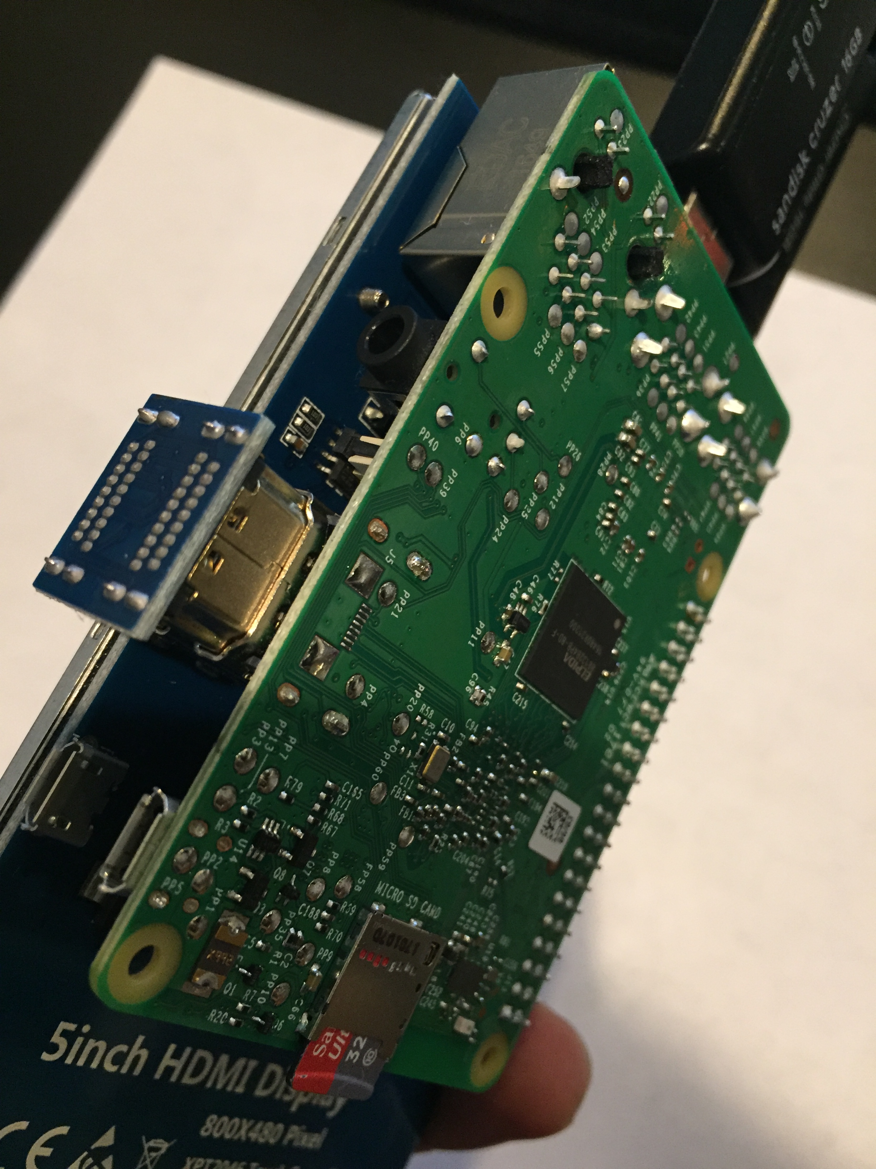
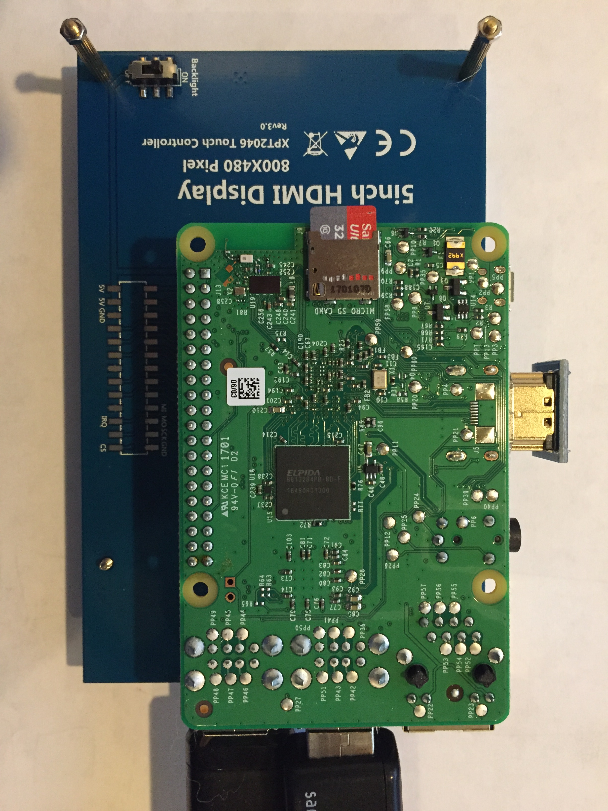
User Interface & Device Design
The Program & Device the patient will interact with (created with Tkinter)
Notes:
Middle (5, 1)

Slide 18
Cupertino High School
Attach this to the top right side of your tri-fold
Notes:
Right Top

Slide 19
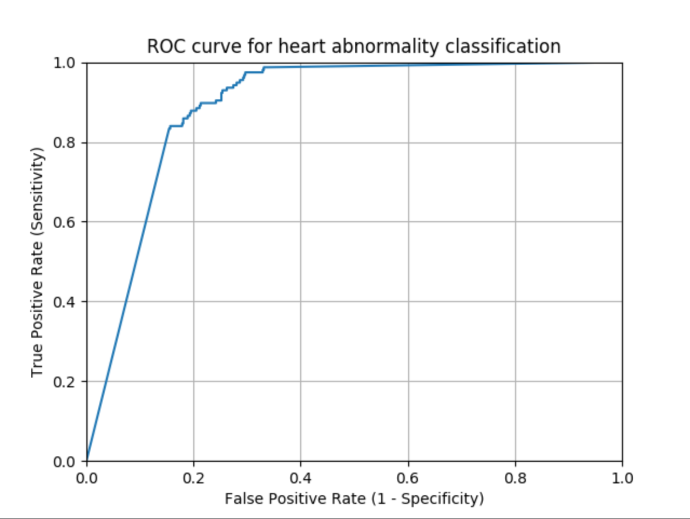
ROC Curve & AUC
Analysis of Results
Specificity - how good the model at detecting the positives
Specificity - how good the model is at avoiding false alarms
The ROC (Receiver Operating Characteristic Curve) is a plot of the true positive rate against the false positive rate for different cutoffs.
It shows the tradeoff between sensitivity and specificity (any increase in sensitivity will be accompanied by a decrease in specificity).
The closer the curve follows the left-hand border and then the top border of the ROC space, the more accurate the test.
The area under the curve is a measure of test accuracy.
AUC = 0.88984
The area under the curve is the percentage of randomly drawn pairs for which the model correctly identifies the “normal” and “abnormal” heartbeat.
Notes:
Right 1

Slide 20
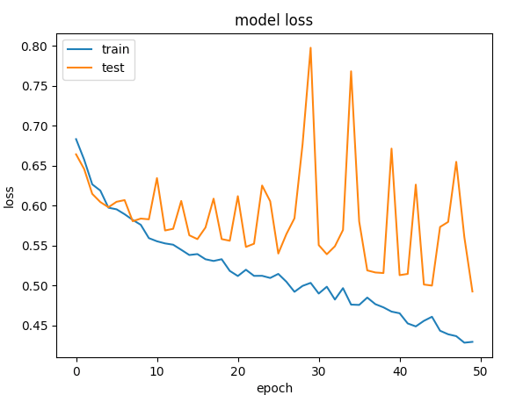
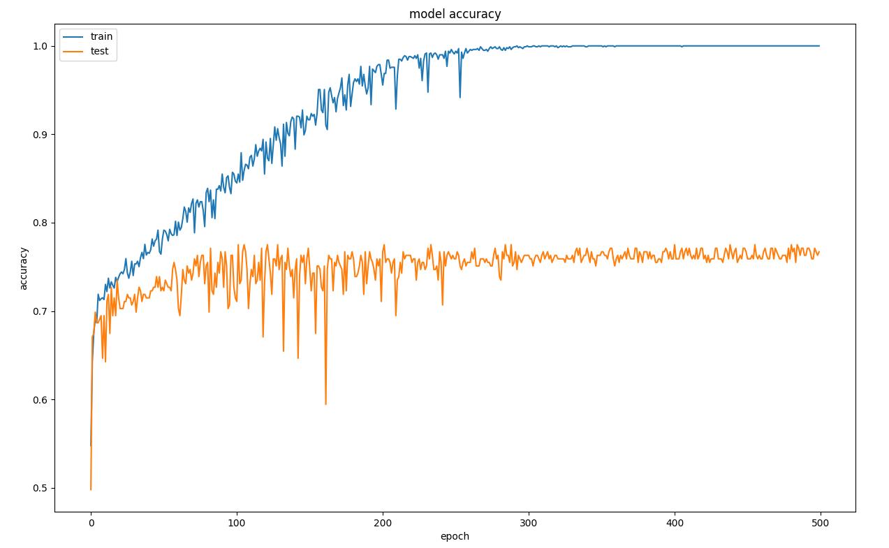
Results
In general, as the number of epochs (1 epoch = 1 full run through of the data) increased, the model loss and model accuracy increased before plateauing at around an 88.8% validated accuracy, and around a 3% false negative rate. With more data, a deeper network, and a set dedicated GPUs the accuracy and loss will be reduced even further.

Slide 21
Results (Continued)
After Training 10 different classifiers, the Convolutional Neural Network model is deemed favorable due to its high validation accuracy, high specificity, and low prediction time.
The results are very encouraging because the model was able to achieve an AUC score of 0.88 and an accuracy of over 82%. These results are in some cases better than a medical professional or healthcare worker could would be able to do.
Furthermore, this device can make a diagnosis in under 30 seconds, wheres it would take a healthcare worker or doctor at least 10-20 minutes to perform a full examination before he/she would be able to deliver a diagnosis.

Slide 22
Hypothesis Testing for Statistical Significance

Slide 23
Software / Hardware Used
Software
Python 3.6.1
Tensorflow (Backend)
Keras
Numpy / Scipy
Librosa
Scikit-Learn
H5PY
Matplotlib
Pickle
PyAudio
Hardware
Raspberry Pi 3
Dual Head Stethoscope
Omnidirectional Condenser Microphone
5’’ Touchscreen LCD
USB External Storage (for SWAP space)
Notes:
Right (1, 0)

Slide 24
Future Work
In the future, I want to train my data on Tachycardia, Bradycardia, Supraventricular, Ventricular, and Bradyarrhythmias arrhythmia sounds so that it can discern the specific kind of arrhythmia a patient has.
Work on creating a mobile app (with TensorFlow Mobile) that utilizes this deep learning model to diagnose anyone, anywhere on the go.
Develop software for Apple Watch OS which monitors a user’s pulse and sends real time data to health care professionals.
Create Ensemble Voting Classifier which uses the top 5 Machine Learning Models found in this project and makes a prediction based on the majority vote.

Slide 25
Bibliography
Kolata, Gina. "A ‘Game Changer’ for Patients With Irregular Heart Rhythm." The New York Times. The New York Times, 13 Dec. 2017. Web. 15 Dec. 2017. <https://www.nytimes.com/2017/12/13/health/heartbeat-tachycardia-radiation.html>.
"Diagnosing Heart Diseases in the Data Science Bowl: 2nd Place, Team Kunsthart." No Free Hunch. N.p., 17 May 2016. Web. 15 Dec. 2017. <http://blog.kaggle.com/2016/04/13/diagnosing-heart-diseases-with-deep-neural-networks-2nd-place-ira-korshunova/>.
"How Doctors Detect Heart Abnormalities through Sound : The Pulse." WHYY. N.p., n.d. Web. 15 Dec. 2017. <https://whyy.org/segments/how-doctors-detect-heart-abnormalities-through-sound/>.
Quinn, Kieran L. "Auscultation: Learning to Listen." CMAJ : Canadian Medical Association Journal. Canadian Medical Association, 01 Apr. 2014. Web. 15 Dec. 2017. <https://www.ncbi.nlm.nih.gov/pmc/articles/PMC3971041/>.
Ujjwalkarn. "An Intuitive Explanation of Convolutional Neural Networks." The Data Science Blog. N.p., 28 May 2017. Web. 19 Feb. 2018. <https://ujjwalkarn.me/2016/08/11/intuitive-explanation-convnets/>.
CS231n Convolutional Neural Networks for Visual Recognition. N.p., n.d. Web. 19 Feb. 2018. <http://cs231n.github.io/convolutional-networks/>.
"Heart Arrhythmia." Mayo Clinic. Mayo Foundation for Medical Education and Research, 27 Dec. 2017. Web. 19 Feb. 2018. <https://www.mayoclinic.org/diseases-conditions/heart-arrhythmia/symptoms-causes/syc-20350668>.
"When Your Heart Rhythm Isn't Normal." WebMD. WebMD, n.d. Web. 19 Feb. 2018. <https://www.webmd.com/heart-disease/guide/heart-disease-abnormal-heart-rhythm#1>.
"Precision, Recall, Sensitivity and Specificity." Ubershmekel's Uberpython Pythonlog. N.p., 01 Jan. 2012. Web. 19 Feb. 2018. <https://uberpython.wordpress.com/2012/01/01/precision-recall-sensitivity-and-specificity/>.
McFee, Brian, Colin Raffel, Dawen Liang, Daniel PW Ellis, Matt McVicar, Eric Battenberg, and Oriol Nieto. "librosa: Audio and music signal analysis in python." In Proceedings of the 14th python in science conference, pp. 18-25. 2015.

